Slide 1
Crime Patterns Analysis and Anomaly Detection in Law Enforcement using Machine Learning
CST8502: Machine Learning
Professor: Dr. Anu Thomas
Presented by:
Abu Ambia
Redwan Wadud
Ibrahim irfan

Slide 2
Business Understanding
In this project, we will apply machine learning techniques, classification using decision trees and anomaly detection in particular, to analyze crime and police-related incidents. We will leverage structured data such as time and location of an incident, as well as response details to accurately classify incidents and identify non-realistic patterns that could be used as means to identify emerging threats, rare events and data inconsistencies.

Slide 3
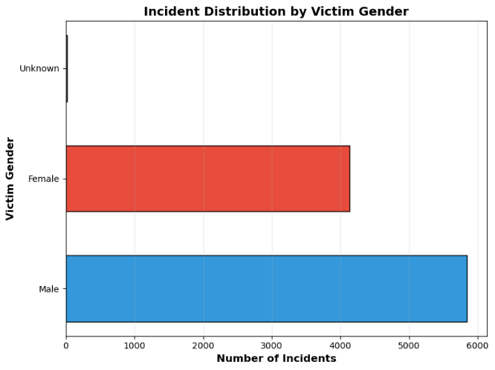
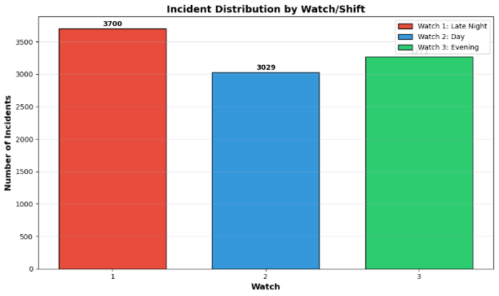
Data Understanding
To understand the data, we identified relationships among attributes such as Watch/Shift,
Number Incidents, and Top 20 NIBRS Categories.

Slide 4
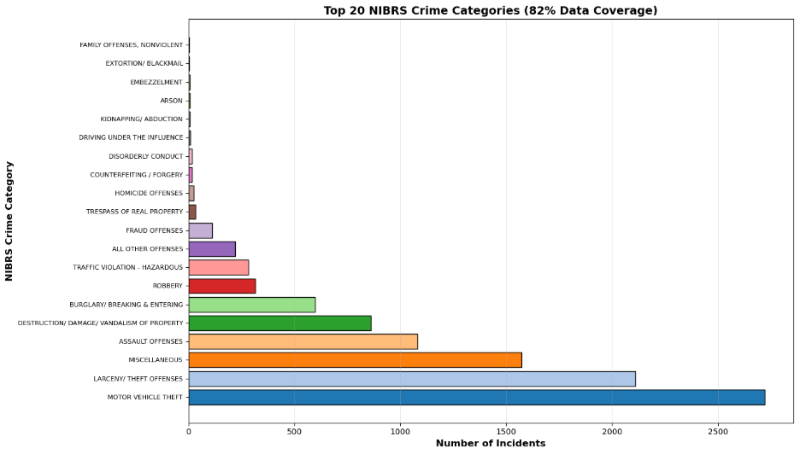
Data Understanding

Slide 5
General Data Preparation
For general data preparation, we had to rename some attributes because they had incorrect labels.
We dropped the ID column to remove duplicates.
17 attributes has over 60% missing data so they immediately discarded.
Categorical attributes had to be converted.
There was a lot of redundant Date-Time data so we find the Response Time and Time Taken to Report.
We clustered X Coordinated and Y Coordinates into Zones before dropping all irrelevant attributes.

Slide 6
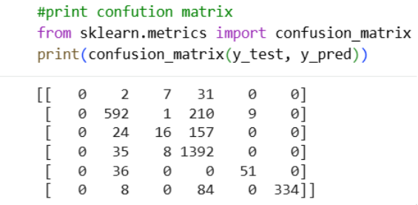
Classification by Decision Tree
Target Column: Type of Incident
Grouped all unique values into 6 Categories
Model Accuracy : 79.6%

Slide 7
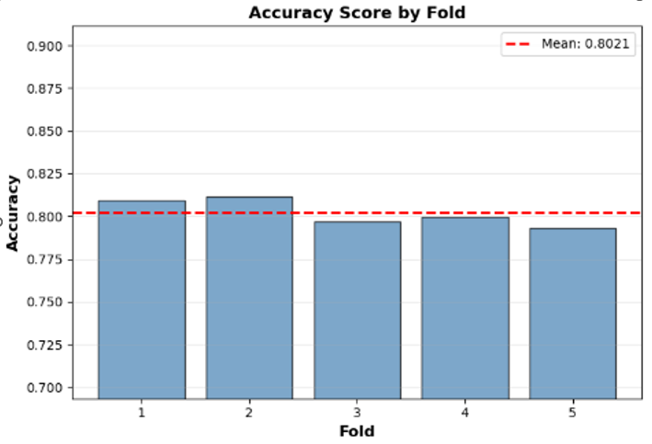
K-fold Cross validation

Slide 8
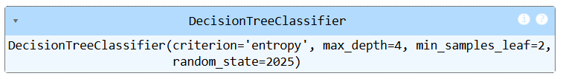
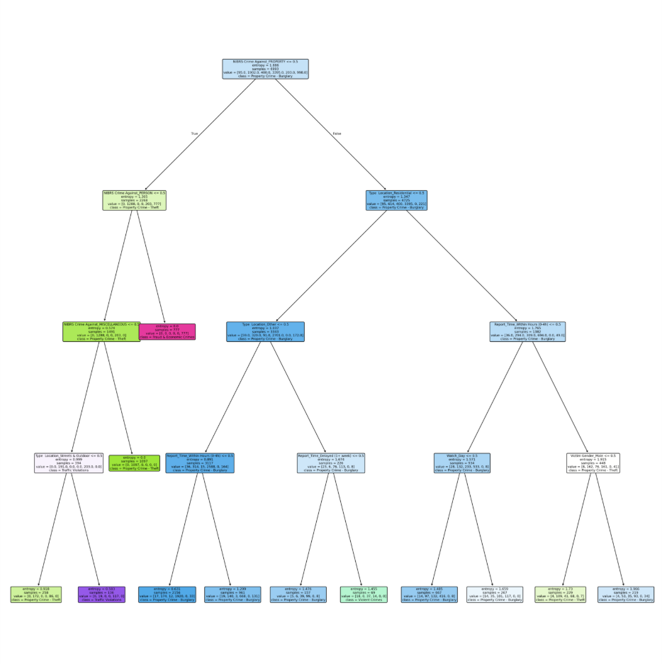
Decision Tree
Example rule: If the crime is not coded as “against property”, and not coded as “against a person”, and it is in the NIBRS “Miscellaneous”/other category, THEN the tree predicts Fraud & Embezzlement.

Slide 9



Clustering
METHODOLOGY
K-Means clustering with K=10 clusters to identify anomalous police incident records
Key Features Used
CATEGORICAL
NUMERIC
Watch • Day of Week
Crime Against • Crime Category
Response Time • Time Taken to Report
X & Y Coordinates
418
4.2%
3
Outliers Detected
of Total Dataset
Outlier Clusters

Slide 10
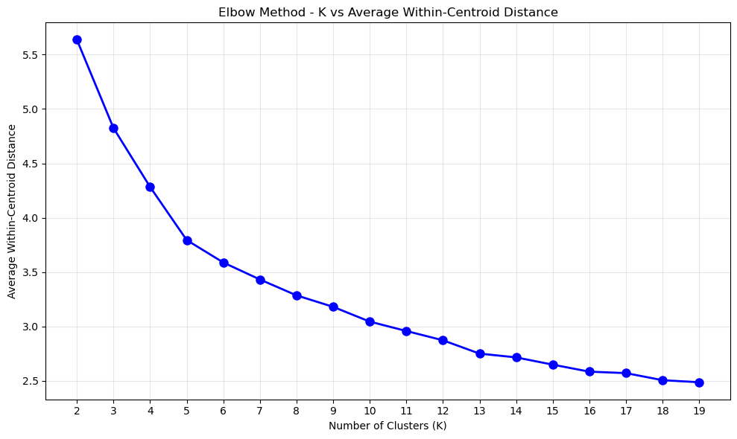
Elbow Diagram

Slide 11
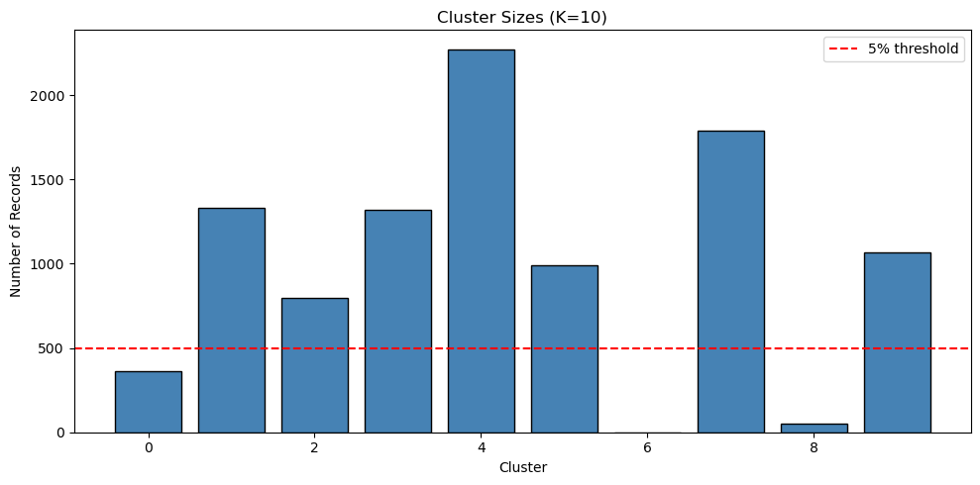
Clusters Bar chart

Slide 12
Clustering results
CLUSTER 0
364 records (3.6%)
AVG RESPONSE TIME
PRIMARY CHARACTERISTIC
25 hours
High response times dominated by property crimes (51% Motor Vehicle Theft)
5× dataset average (4.8h)
CLUSTER 6
1 record (0.01%)
TIME TO REPORT
PRIMARY CHARACTERISTIC
40 years
Extreme data anomaly indicating data entry error requiring removal
351,012 hours
CLUSTER 8
53 records (0.5%)
AVG RESPONSE TIME
PRIMARY CHARACTERISTIC
88 hours
Most extreme delayed responses (max: 292 hours), predominantly property crimes
18× dataset average (4.8h)

Slide 13
Outlier Detection
The data that was prepared during general data preparation consisted 22 attributes.
Four methods were used to detect outliers:
Local Outlier Factor (LOF): A density-based method that identifies outliers based on local neighborhood density
Isolation Forest (ISF): A tree-based ensemble method using recursive partitioning to isolate anomalies
One-Class SVM: A boundary-based method learning decision boundaries around normal data
Mahalanobis Distance-Based Detection: A statistical method measuring multivariate distance from the data centroid

Slide 14
Model Specific Feature Engineering
Since we already clustered Latitude and Longitude into Zones, X Coordinate and Y Coordinate were dropped.
For numerical data, missing values were replaced my the mean and categorical values were replaced by “Unknown”.
The dataset was unified by combining engineered features with original attributes. Numerical and categorical features were processed separately and then integrated into a cohesive dataset suitable for all four outlier detection methods
After feature engineering, One-Hot Encoding, was applied on categorical data.
The was then split into training data and testing data following normalization on numerical data.

Slide 15
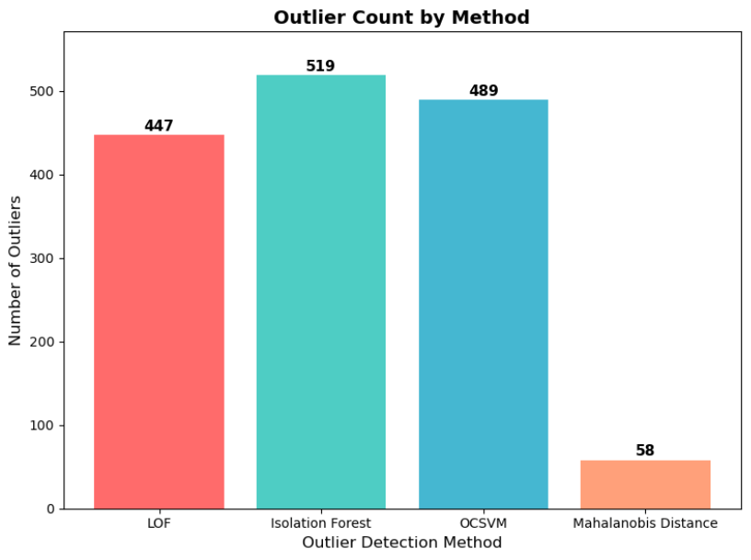
Outlier Detection Results
The four methods demonstrated varying
levels of sensitivity:
Local Outlier Factor: 447 outliers detected
Isolation Forest: 519 outliers detected
(highest)
One-Class SVM: 489 outliers detected
Mahalanobis Distance: 58 outliers
detected (lowest)
LOF, ISF, and One-Class SVM showed
strong consensus, sharing 438 common
detections. This overlap suggests high
reliability for these instances as genuine
anomalies. In contrast, Mahalanobis
Distance's conservative approach
resulted in only 9 records overlapping with
all other methods.

Slide 16
Common Outliers
Index | Incident Type | Key Attributes | Reason for Outlier | Additional Reasons
77 | Shooting (Agg Assault) | Response Time: 5.99 hrs, Report Delay: 3.35 hrs | Extremely high severity (shooting) combined with long response time. High MD score (12.03). | Geospatial anomaly; rare shooting in low-crime beat; multivariate deviation.
38 | Unauthorized Use of Motor Vehicle | Response Time: 0.86 hrs, Report Delay: 3.52 hrs | Quick response but long reporting delay. MD score (8.99) suggests spatial/temporal anomaly. | Crime-context mismatch; unusual location for UUMV; temporal irregularity.
149 | Burglary Motor Vehicle | Response Time: 2.04 hrs, Report Delay: 17.21 hrs | Very long reporting delay compared to typical BMV cases. High MD score (8.25). | Long reporting delay; property crime in atypical sector; feature interaction anomaly.
280 | Major Accident | Response Time: 2.20 hrs, Report Delay: 1.25 hrs | Accident cases usually have faster response; slower than norm. MD score (6.96). | Accident response slower than norm; unusual day/time pattern; spatial deviation.
91 | Routine Investigation (BMV) | Response Time: 0.65 hrs, Report Delay: 138.45 hrs | Extremely delayed reporting (almost 6 days). Highest MD score (77.36). | Extreme temporal anomaly (6-day delay); rare pattern for BMV; highest MD score.
93 | Criminal Mischief | Response Time: 3.30 hrs, Report Delay: 38.83 hrs | Very long reporting delay for vandalism. MD score (6.41). | Unusual vandalism context; long delay; demographic rarity for location.
358 | Robbery of Business | Response Time: 3.09 hrs, Report Delay: 0.10 hrs | Robbery cases usually have immediate response; unusually slow here. Negative LOF deviation. | Robbery response unusually slow; rare victim demographic; negative LOF indicates isolation.
380 | Burglary Motor Vehicle | Response Time: 2.10 hrs, Report Delay: 10.73 hrs | Reporting delay is high for BMV cases. MD score (13.06). | High reporting delay for BMV; location uncommon for crime type; strong MD anomaly.
402 | Unauthorized Use of Motor Veh | Response Time: 2.04 hrs, Report Delay: 12.18 hrs | Longer delay than norm. MD score (6.42) and negative LOF show deviation from cluster norms. | Combination of long delay and location anomaly; negative LOF and MD deviation.

Slide 17
Conclusion
For next steps, we recommend that these outlier records be reviewed by domain experts and that the 9 universal outliers be treated as critical anomalies requiring immediate investigation.
The classification models could be deployed as decision support tools for police dispatchers, and regular retraining on updated data would keep the models current with evolving crime patterns
Ultimately, this project demonstrates the power of combining multiple machine learning techniques to transform raw police incident data into actionable intelligence. By identifying patterns, classifying incidents, and detecting anomalies, we can support smarter, safer, and more effective policing.

Slide 18
Thank You

